Slide 1






Predictive Analysis and Risk Evaluation of DMart Stock Prices:
From Price Movements to Risk Sensitivity: A Comprehensive Study on DMart:
Presented BY:
SHAIKH MARYAM ALIMUDDIN.
MSc Applied Statistics - MSAS116
1

Slide 2



DMart & NIFTY 50:
What is Nifty?
It represents the top 50 companies listed on the NSE.
Similar to Sensex, Nifty serves as a benchmark for tracking the performance of the Indian stock market but with 50 companies.
What is Avenue Supermarts Ltd.?
Dmart Leading retail chain in India.
Why DMart?
Retail superstar: Dominates Indian grocery & essentials market 🛒
Consistent performer: Strong growth even during market hiccups 📈
Defensive stock vibes: Protects investments when markets get wild ⚡
Sudden Dip Alert: Despite its past bullish trend, DMart recently went bearish 📉
3

Slide 3
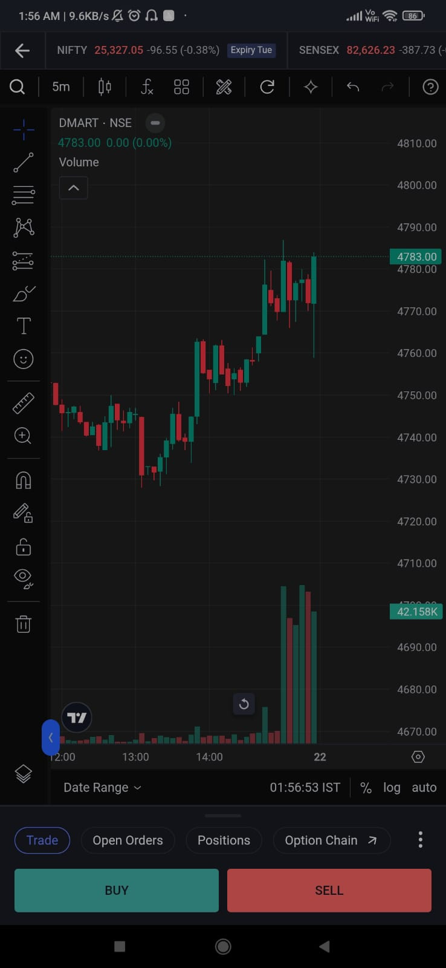


Spot the Trend?
“Based on this chart alone… do you think the price will go UP or DOWN tomorrow?” 🤔
“Hint: There’s more than just the chart to know… let’s explore!”

Slide 4
Objectives:
The specific objectives of the project are:
To determine whether DMart stock is a risky or safe investment.
To identify the best time to invest in and exit from DMart stock.
To evaluate whether DMart is a profitable company for investors.
To analyze the returns and volatility of DMart.
To assess whether long-term or short-term investment is preferable.
To evaluate the accuracy of stock price prediction models applied to DMart.
2

Slide 5
Methodological Framework
7

Slide 6


Data Description:
Source: Yahoo Finance & NSE
Period: Last 2 years (~594 observations)
Variables: Close Price, Daily Returns
Preprocessing:
Converted dates into datetime format and aligned both datasets on common trading days.
Returns were calculated as:
where = Closing price on day t.
Missing values were not present in data.
5

Slide 7

DMart Financial Snapshot:
(FY23–24 vs FY24–25)
📈 Revenue (₹ Cr): 49,533 → 57,790 (+16.67%) ✅ Beneficial
💰 Profit After Tax (PAT, ₹ Cr): 2,694.92 → 2,927.18 (+6.61%) ✅ Beneficial
📊 Net Profit Margin: 5.44% → 5.06% (–0.38 ppt) ⚠️ Moderate
🏭 Operating Margin: 9.0 → 8.4 (–0.6 ppt) ⚠️ Moderate
🏦 Return on Equity (ROE): 13.53% (Stable) ✅ Beneficial
📌 Return on Capital Employed (ROCE): 19.66% (Improving) ✅ Beneficial
📘 Book Value (per share): ₹329 ⚪ Neutral
6

Slide 8
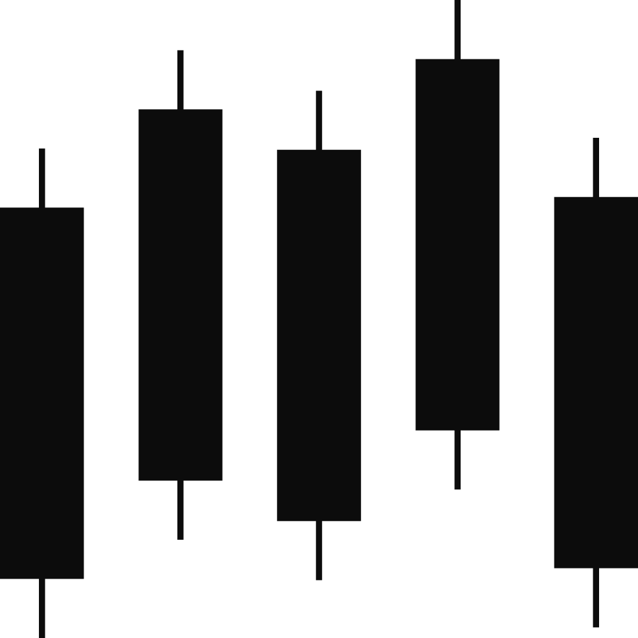
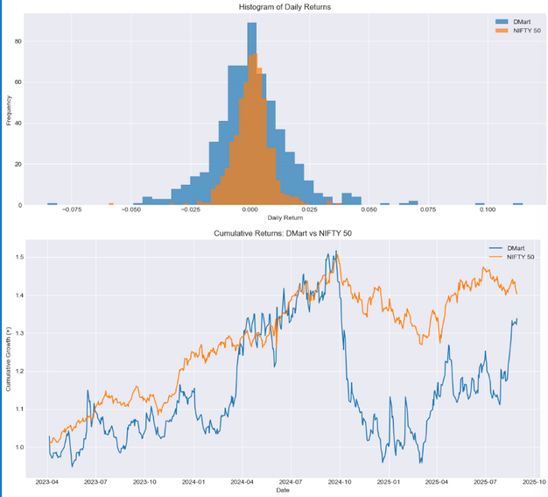
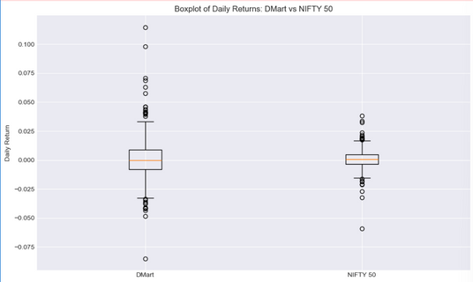
Exploratory Data Analysis (EDA):
Boxplot: DMart shows wider spread & outliers → higher volatility than NIFTY.
Histogram: Returns are bell-shaped but with heavy tails (extremes).
Cumulative Return: DMart shows strong long-term growth, NIFTY steadier.
Correlation: Weak correlation (0.21) → DMart moves independently of NIFTY.
8

Slide 9
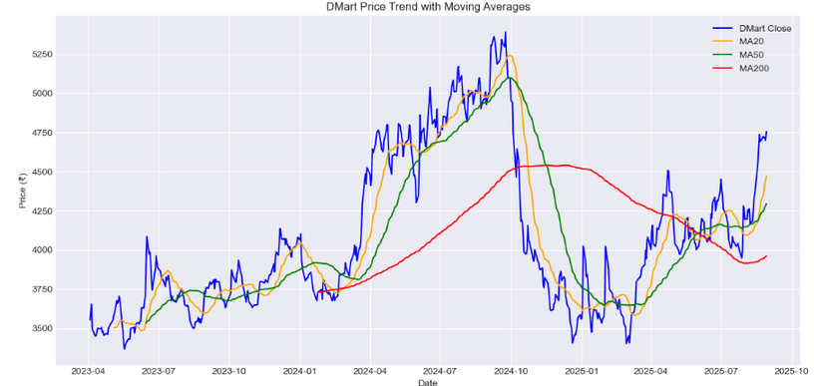
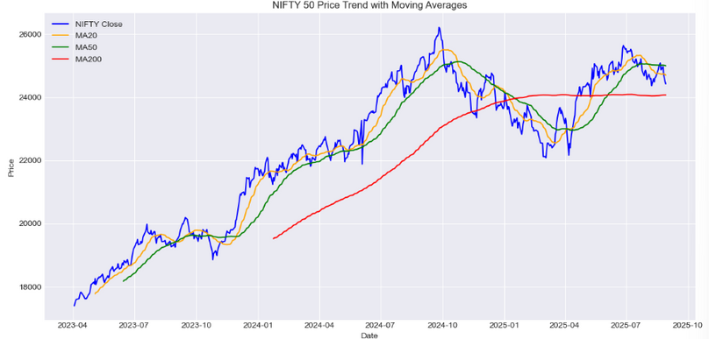
Moving Averages Of Nifty50 and Dmart:
Smooth out noise: Reduces daily price fluctuations, shows real trend
.Identify trends:
20-day → short-term
50-day → medium-term
200-day → long-term
Golden Cross = Bullish ✨
Death Cross = Bearish ⚠️
9

Slide 10
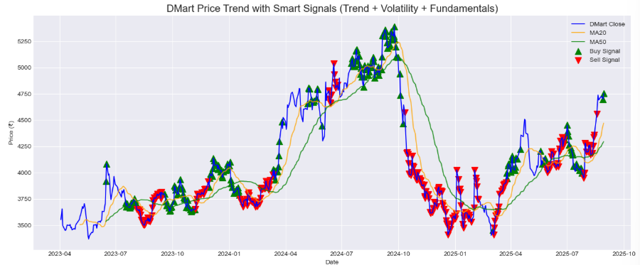

best time to invest in and exit from DMart stock:
Dmart price Trend with signals based on Trend, Volatility and Fundamentals:
4

Slide 11
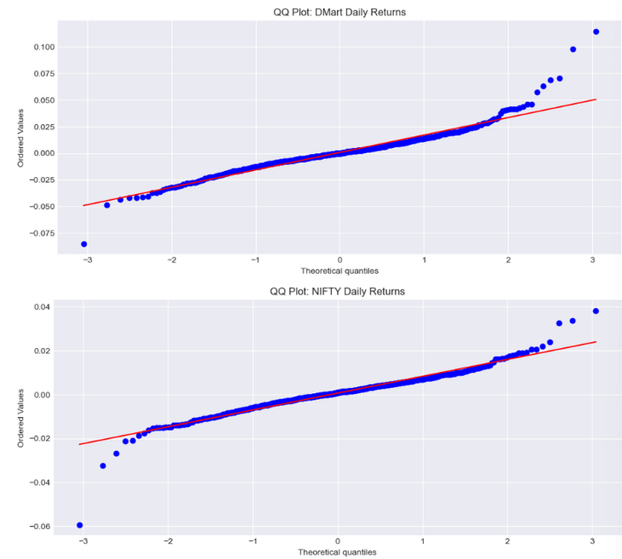
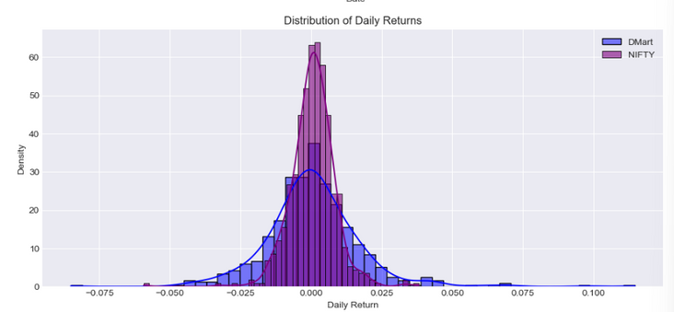
Statistical Tests on DMart vs NIFTY50:
Normality (Shapiro-Wilk Test)
Both DMart & NIFTY: p < 0.05 → reject perfect normality
BUT visual plots (Q-Q, histogram) ≈ bell-shaped → approx normal ✅
🔑 Takeaway: Enough normality to proceed with analysis
Levene’s Test (Volatility Check)
Statistic = 121.97, p ≈ 0 → variances not equal
DMart much more volatile/jumpy than NIFTY ⚡
Welch’s t-Test (Mean Returns)
Statistic = 0.0395, p ≈ 0.968 > 0.05
No significant difference → DMart & NIFTY daily returns ≈ same 📈
Confidence Interval (DMart – NIFTY)
95% CI for mean diff: (–0.0015, +0.0015)
Confirms returns are statistically equal
DMart One-Sample t-Test
T = 0.90, p = 0.36 → mean daily return (0.06%) not significantly > 0
🔑 Takeaway: DMart does earn small daily gains, but not statistically huge
4

Slide 12

Annualized Performance & Risk Metrics:
Annualized Returns & Volatility
📈 DMart Return: 17.32% | Volatility: 27.06%
📊 NIFTY50 Return: 16.43% | Volatility: 12.55%
Sharpe Ratio (Risk-Adjusted Return)
Formula: (Mean Return – Risk-Free Rate) ÷ Std. Dev. of Returns
DMart: 0.42 → weaker risk-adjusted returns
NIFTY50: 0.83 → better balance of risk & reward
🔑 Takeaway: DMart is profitable but not optimal for risk-averse investors
Beta vs NIFTY (Systematic Risk)
Beta = 0.45
Interpretation: DMart moves less than half as much as NIFTY
Attitude: “Independent” → calmer than market swings
6

Slide 13
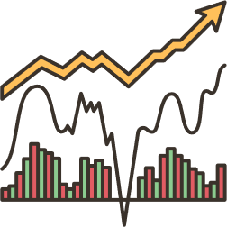
DMart Risk Classification (2 Years Data):
Volatility-Based Risk
Annualized Volatility: 27.06% → Risky ⚠️
Quartile/Minimum Return Risk
Q1 = –0.81%, Min Return = –8.5%
Classification: Beneficial (limited downside risk) ✅
Trend-Based Risk
Current Price > MA200 → Beneficial Trend 📈
Overall Risk Classification: Beneficial ✅
DMart shows moderate volatility, stable trend, and controlled downside risk
6

Slide 14

Modeling Approaches
8

Slide 15
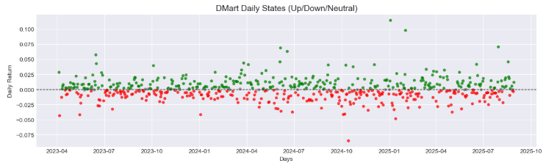
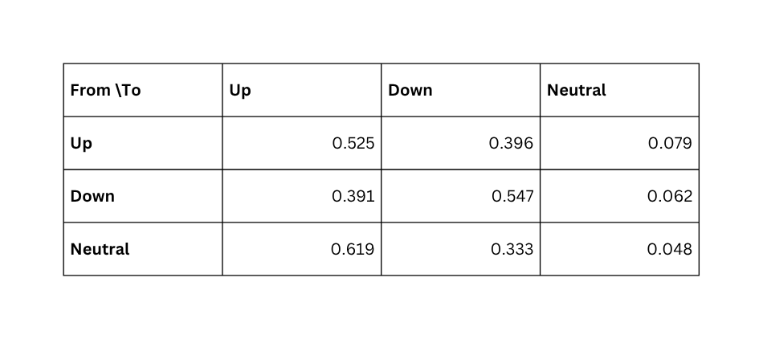
Markov Chains:
To analyze short-term stock dynamics, we classified DMart’s daily returns into three states:
a. Up: Return > 0.1%
b. Down: Return < -0.1%
c. Neutral: Return between -0.1% and 0.1%
Transition Probability Matrix:
This matrix shows the likelihood of moving from one state to another on consecutive days.
Insight: DMart shows persistence in trends — ~52% chance of staying Up once Up, ~55% chance of staying Down once Down.
8

Slide 16
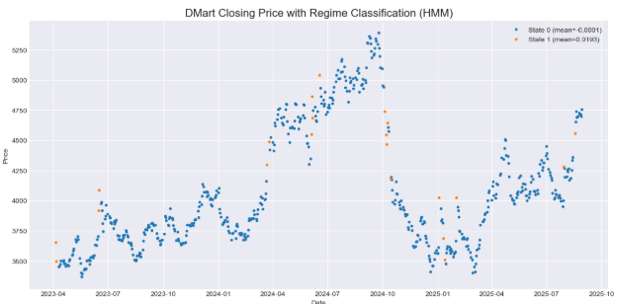
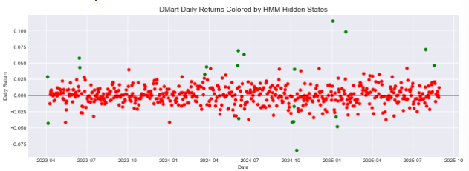
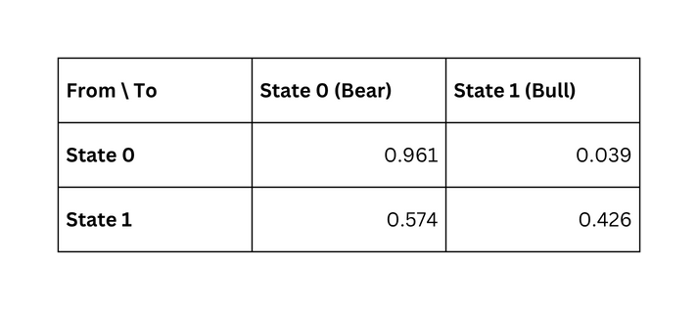
Hidden Markov Models (HMM):
We applied a 2-state Gaussian Hidden Markov Model (HMM) to DMart’s daily returns to identify hidden market
regimes, broadly classified as Bull and Bear.
Regime Classification:
State 0 (Bear): Mean return = -0.005%, Volatility = 1.347%
State 1 (Bull): Mean return = 1.934%, Volatility = 5.520%
HMM separates bull (green) and bear (red) phases — bull state has higher returns but also higher volatility.
Hidden states reveal market regimes not obvious in raw returns — green = growth, red = decline.
8

Slide 17
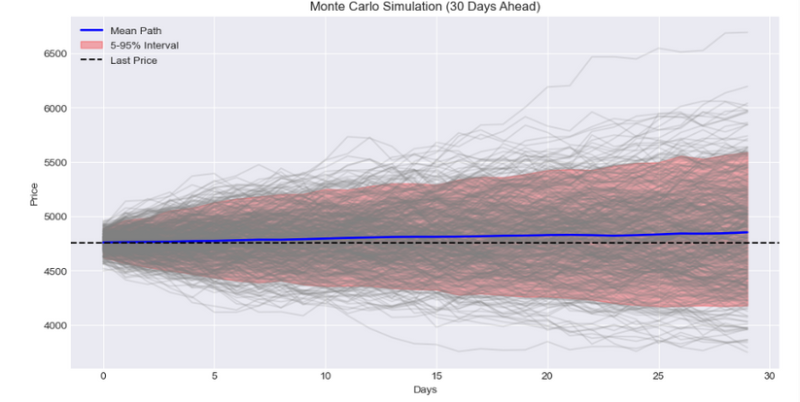

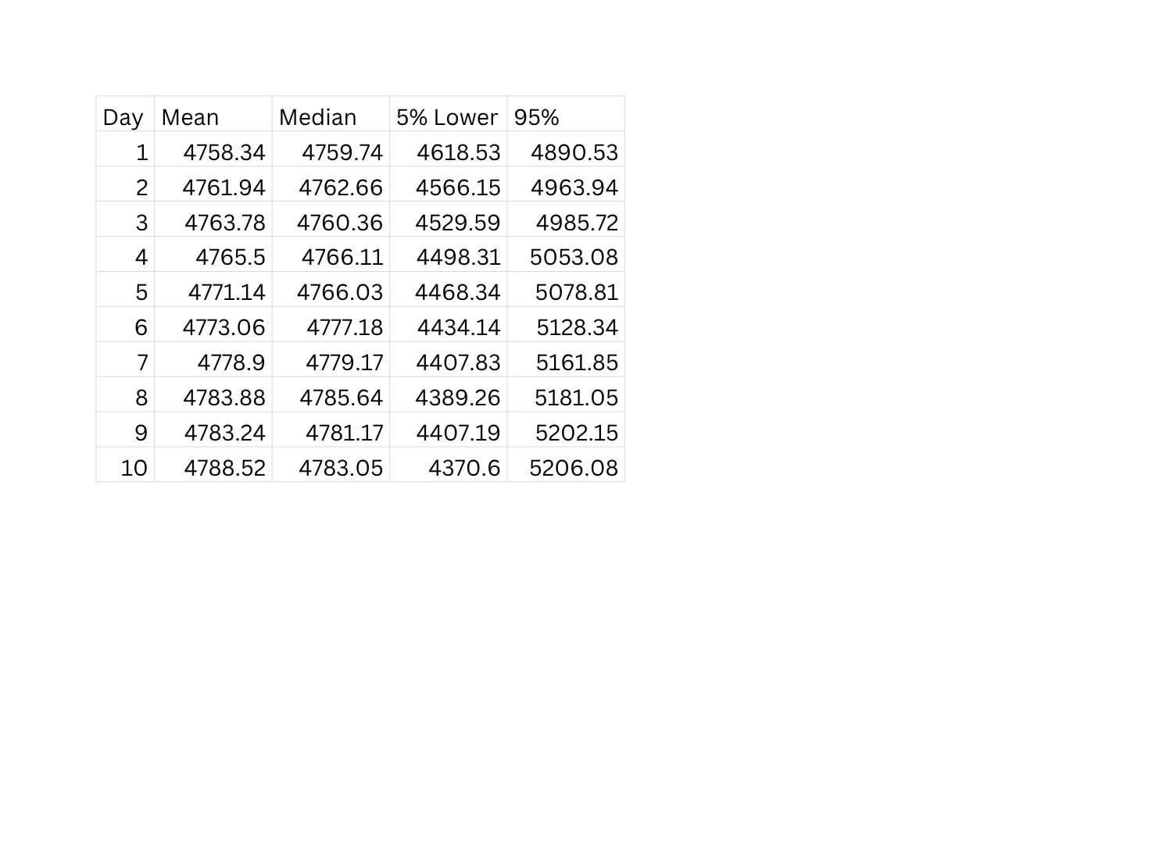
Monte Carlo Simulation:
To estimate DMart’s future stock price movement, we used a Monte Carlo simulation with 500 iterations over a
30-day horizon. The simulation assumes returns are normally distributed with mean and volatility based on
historical daily returns.
Expected Price (mean): ₹4851.64
Median Price: ₹4838.68
5% – 95% Confidence Interval: ₹4177.46 – ₹5590.37
Monte Carlo projects possible price paths
8

Slide 18
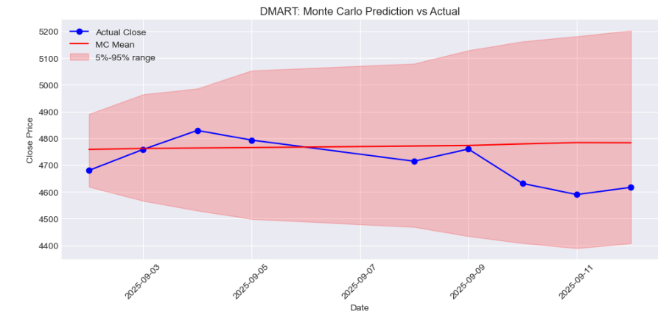
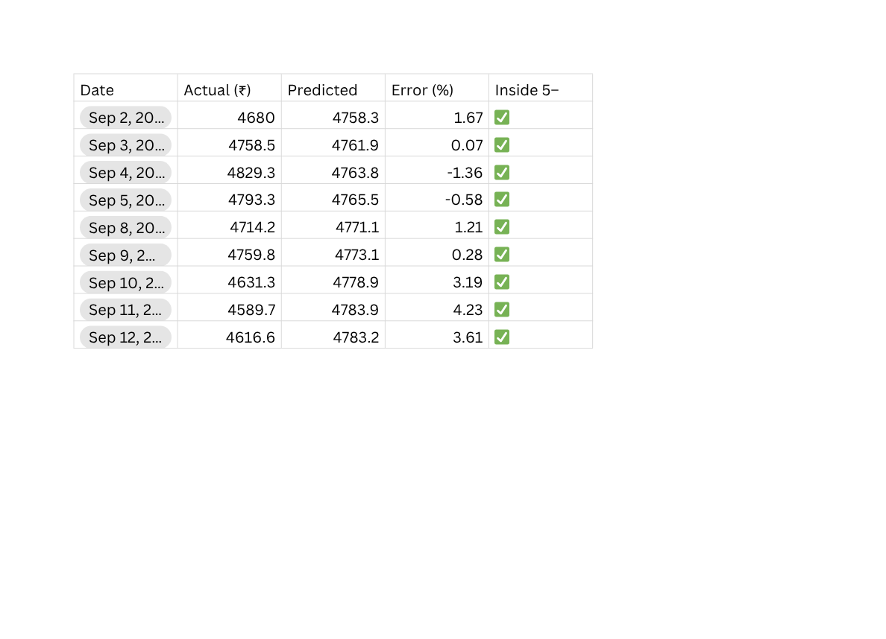
Prediction & Evaluation:
📅 Period: 2nd – 12th Sept 2025
MAE: ₹83.75 → Avg. forecast error ~₹84
RMSE: ₹106.40 → Moderate error magnitude
Reliability: ✅ 100% (all actual prices inside 5%-95% CI)
Direction Accuracy: ⚡ 37.5% (weak on daily up/down movement)
Daily Error: -1.36% to +4.23% (uncertainty grew with time)
🔑 Insights:
All prices stayed within the 5–95% confidence range → Reliability = 100% ✅
Errors small early on, but grew with time (classic Monte Carlo behavior).
Biggest deviation: +4.23% on 11-Sep.

Slide 19
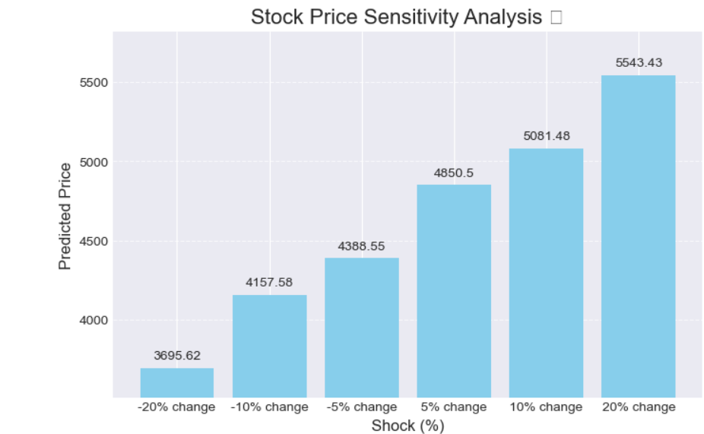

Sensitivity Analysis:
To understand how sensitive DMart’s stock is to sudden price shocks, we applied hypothetical changes (±5%, ±10%, ±20%) to the last observed closing price and estimated the adjusted predicted values.
If today’s price changes by ±20%:
–20% → ₹3695
+20% → ₹5543
8

Slide 20
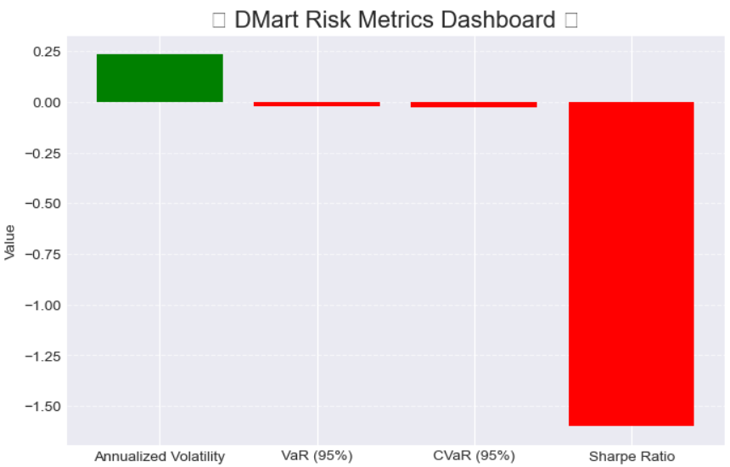
Risk Metrics:
Annualized Volatility: 27.46%
VaR (95%): –2.33%
CVaR (95%): –2.7%
Sharpe Ratio: –1.6 (weak risk-adjusted returns)
1

Slide 21
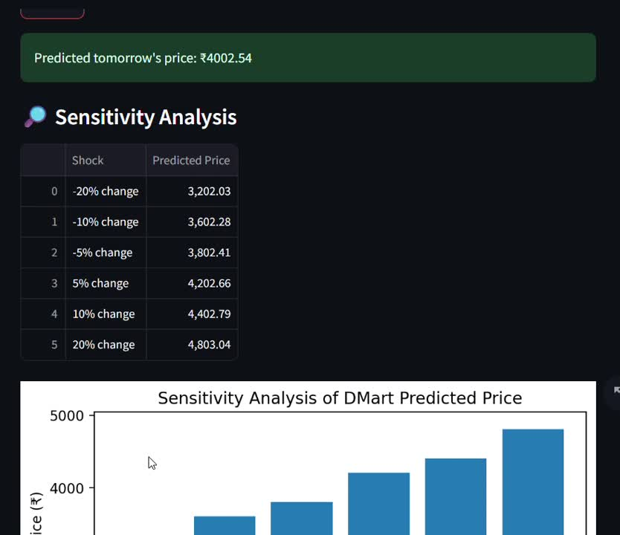

Applications Developed:
DMart-Specific App → Predict tomorrow’s price + risk metrics
2

Slide 22
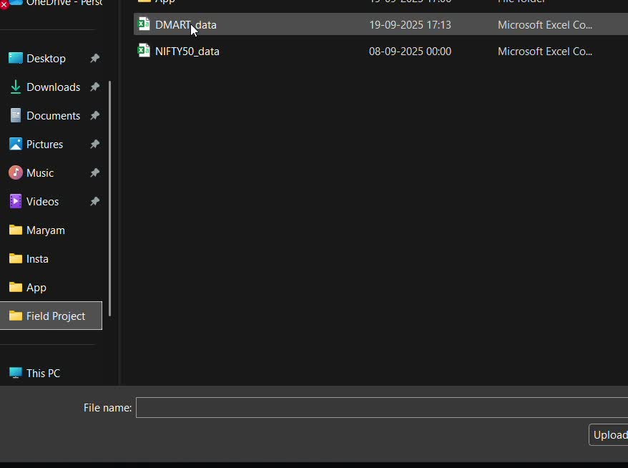
Universal CSV App → Upload any stock CSV, get next-day forecast
6

Slide 23

Discussion:
📈 Positive but Volatile: DMart gives strong long-term returns, but volatility (27%) > implied by Beta.
🛡️ Diversification: Weak correlation (0.21) with NIFTY → acts defensively in a portfolio.
⚖️ Risk-adjusted Returns: Sharpe Ratio (-1.6) < NIFTY → less attractive for risk-averse investors.
🔮 Prediction Models: Monte Carlo & stats capture range/trend, weak on short-term direction.
🐂🐻 Regime Detection: Markov/HMM reveal bull & bear phases → guides entry/exit timing.
8

Slide 24

Limitations & Remarks:
Close Price Usage: Only “Close” values were available in the dataset; Adjusted Close (corporate actions) was not incorporated.
Short Horizon: Forecasts were limited to ~10–30 trading days; longer horizons were not tested.
Baseline Comparison Missing: Models weren’t benchmarked against simpler methods (e.g., Random Walk).
Direction Accuracy: While ranges were reliable (100% within bounds), day-to-day direction accuracy was modest (~37%).
Model Assumptions: Methods like Monte Carlo, Markov, and HMM capture randomness and trends but can’t account for external shocks (e.g., policy changes, competitor impact).
8

Slide 25


Future Work:
Use Adjusted Close prices instead of raw Close for more accurate return calculations.
Integrate macroeconomic indicators (inflation, consumer demand, competition from quick-commerce apps) to improve forecasting.
Benchmark against baseline models (e.g., Random Walk, ARIMA) for stronger evaluation.
Enhance prediction models with hybrid approaches (HMM + Monte Carlo, Deep Learning).
Portfolio-level analysis: Extend beyond DMart to multi-stock or sector-based investment strategies.
Deploy enhanced apps with live API data for real-time price prediction & trading signals.
8

Slide 26

Conclusion:
Analysis showed DMart has higher volatility (27%) but is still classified as Beneficial in trend-based risk analysis.
Moving average crossovers and regime models (Markov/HMM) highlighted bullish/bearish phases for timing entries and exits.
Long-term returns are positive and comparable to NIFTY, but with higher short-term risk.
Comprehensive statistical tests, Sharpe Ratio, and Beta analysis quantified both returns and volatility.
Results suggest short-term risk is high, but long-term investment appears favorable for risk-tolerant investors.
Models like Monte Carlo captured price ranges reliably (100%), but short-term direction accuracy was limited (37%).
8

Slide 27

References:
· Data Sources
Yahoo Finance – DMart Historical Stock Data. Retrieved via Python yfinance library, 2025. https://finance.yahoo.com
National Stock Exchange of India (NSE) – DMart (DMART.NS) Stock Prices. Retrieved 2025. https://www.nseindia.com
Müller, A. C., & Guido, S. (2016). Introduction to Machine Learning with Python. O’Reilly.
Dutt, S., Chandramouli, S., & Das, A. K. (2015). Machine Learning. Pearson.
Tsay, R. S. (2010). Analysis of Financial Time Series. Wiley.
Damodaran, A. (2012). Investment Valuation. Wiley.
8

Slide 28


“The floor is open for queries…”
8

Slide 29


8

